Slide 1
Master-Thesis Methodical Approach for Analyzing Process Variables and Optimizing Boundary Conditions in Multi-Axis Robot Programs
Status Update: 7 weeks left
07.01.2024 – 14.01.2024
Jan Nalivaika

Slide 2
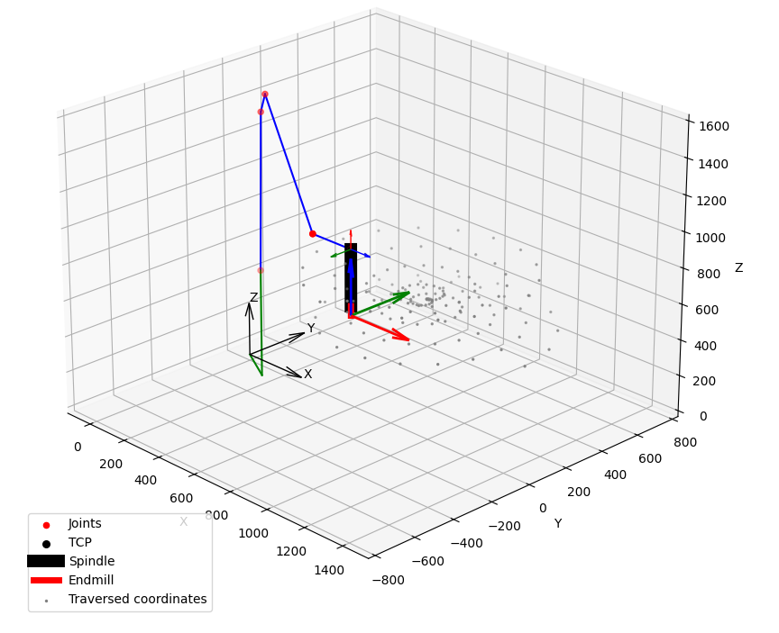
Progress (show cool demonstration here)

Slide 3
Images
„gibt es das Bild schärfer?“
„Farbskala fehlt“

Slide 4
To Do
Zitate = Anpassen
Bilder = Anpassen (Score scale at bottom)
(Ergebnisse = Neu berechnen ?)
Email = Titel-anpassung

Slide 5
Future planning
DATE: Ludwig Marius Jan
19.01 X
26.01 X
02.02 PDF update (Paper start ?) ☺
09.02 ☺
16.02 ☺
23.02 Last possible Changes in PDF ☺
01.03 Defense ?? ☺

Slide 6
Contact
Jan Nalivaika (TUM) Student Otto-Hahn-Ring 6
81739 Munich, Germany
Phone +49 163 7180148
E-mail jan.nalivaika.ext@siemens.com nalivaika@outlook.de
Marius Breuer (Siemens AG)
Supervisor Otto-Hahn-Ring 6
81739 Munich, Germany
Phone +49 (172) 8396287
E-mail marius.breuer@siemens.com
Ludwig Siebert (TUM-IBW)
Supervisor Boltzmannstr. 15
85748 Garching at Munich
Phone +49 (89) 289 – 15578
E-mail ludwig.siebert@iwb.tum.de

Slide 7
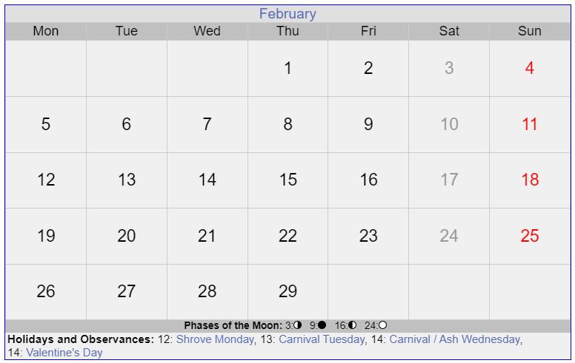

Slide 8
